Slide 1
Testing Strategy
the objective of a software testing strategy is to devise and run a set of test cases that satisfy or cover a set of test requirements.
The test requirements are defined in terms of a software artifact or model of a software artifact, where an artifact may be the requirements, specification, design, program code, etc.
These models are often graphs, for example, ﬂowgraphs.
One testing strategy is to select test cases so that every program statement is executed at least once. This approach is called statement coverage— each statement is a test requirement.

Slide 2
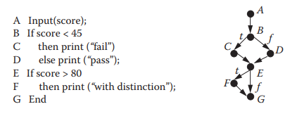
Statement Coverage
Each test case causes one test path through the program to execute.
In terms of the program ﬂowgraph, statement coverage is achieved by finding a set of test cases that execute test paths such that every ﬂowgraph node lies on at least one test path.

Slide 3
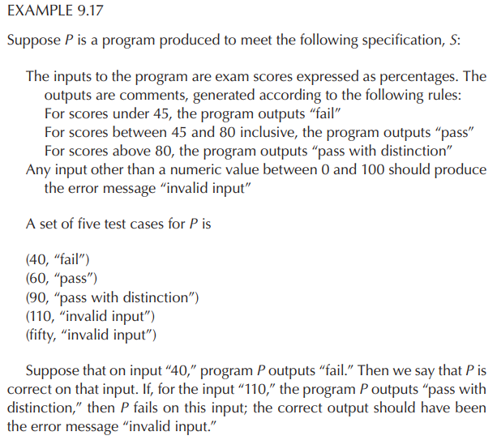
Statement Coverage

Slide 4
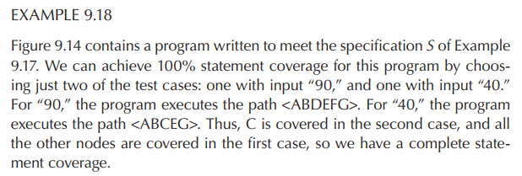
Statement Coverage

Slide 5
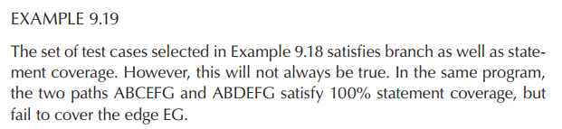
Branch (or edge) Coverage
Another testing strategy is to select test cases so that every program branch is executed at least once.
This approach, called branch (or edge) coverage, means finding test cases that cause the execution of a set of test paths such that every edge lies on at least one test path

Slide 6
Complete Path Coverage
The most exhaustive structural testing strategy is to select test cases such that every possible test path is executed at least once. This approach is called complete path coverage.
complete path coverage requires running every single test path through the ﬂowgraph.
This strategy, although appealing in theory, is normally impossible in practice.
If the program has even a single loop, then complete path coverage can never be achieved because a loop gives rise to an infinite number of test paths.

Slide 7
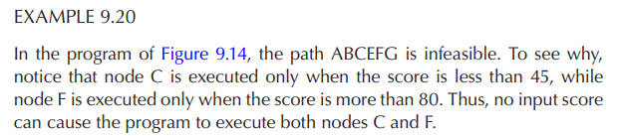
Impediment to structural testing
Another fundamental impediment to any structural testing strategy: infeasible paths.
An infeasible path is a program path that cannot be executed for any input.
The existence of infeasible paths can mean that, in practice, we may not be able to achieve 100% coverage for any structural testing strategy.

Slide 8
Testing Strategy
Researchers have tried to define strategies so that:
They are more comprehensive than statement and branch coverage in the sense of requiring more test cases).
The number of test cases required is finite even when there are loops
Several of these strategies make use of the notion of simple paths and prime paths.
a simple path as a path that does not contain the same node more than once except for the first and last node.
A prime path is a simple path that “does not appear as a proper subpath of any other simple path.

Slide 9
Testing Strategy
Prime path coverage: Testing all prime paths in the ﬂowgraph. This requires testing all cycles that start at reachable nodes, and, depending on the branches inside a loop, requires testing execution paths that cause a loop to cycle two or more times. Prime path coverage satisfies branch coverage, and requires a finite number of tests.
Notes:
Edge-pair coverage: Testing “each reachable path of length up to 2” in the ﬂowgraph.

Slide 10
Minimum Number of Test Cases
test team choose a test strategy.
Before testing starts, the team members must also know the minimum number of test cases needed to satisfy the strategy for a given program.
It helps to generate data for each test case and to understand how much time testing is likely to take.
the test requirements as well as a minimal set of paths that satisfies the strategy.

Slide 11
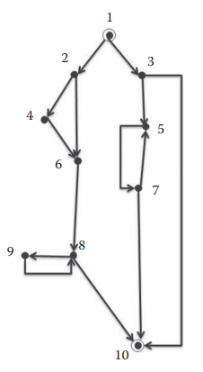


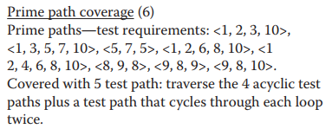
Minimum Number of Test Cases
<1,3,10>, <1,3,5,7,10>, <1,2,6,8,10>, <1,2,4,6,8,10>,
<1,3,5,7,5,7,10>, <1,2,4,6,8,9,8,9,8,10>

Slide 12
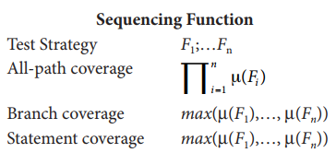
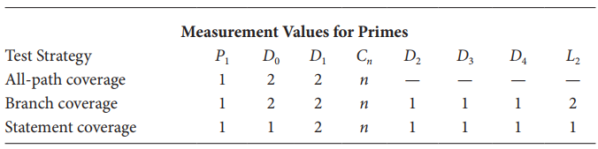
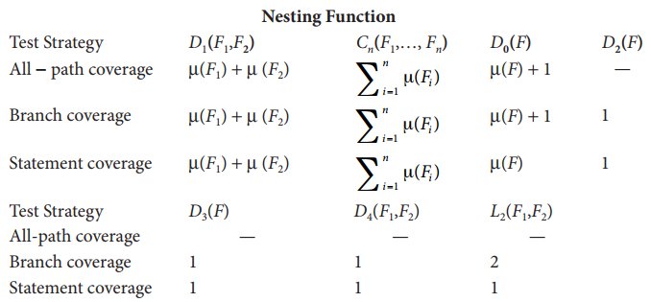
Minimum Number of Test Cases

Slide 13
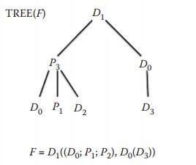
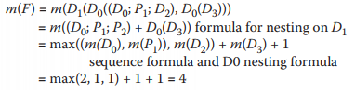
Minimum Number of Test Cases
Computing the minimal number of test paths for the branch coverage criterion:
has some problems in symbol

Slide 14
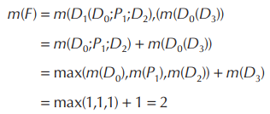
Minimum Number of Test Cases
Computing the minimal number of test paths for the statement coverage criterion:

Slide 15

Test Effectiveness Ratio
For a given program and a set of cases to test it, we would like to know the extent to which the test cases satisfy a particular testing strategy.
Let C be a testing criterion that requires us to cover a class of test requirements (such as paths, linearly independent paths, edges, or statements).
For a given program and set of test cases, the test eﬀectiveness ratio (TER_{C}) is defined as

Slide 16
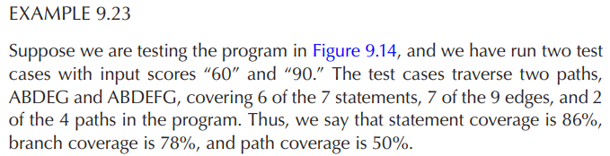
Test Effectiveness Ratio

Slide 17
Cohesion
Cohesion describes how strongly related the responsibilities between design elements
The goal is to achieve “high cohesion”
High cohesion between classes is when class responsibilities are highly related

Slide 18
Coupling
Coupling describes how strongly one element relates to another element
The goal is to achieve “loose coupling”
Loose coupling between classes is small, direct, visible, and has flexible relations with other classes
PackageA
PackageA
Class A1
Class A1
- Class A4
Class A2
- Class A4
Class A2
Class A3
Class A3
PackageB
PackageB
Strong coupling
+ Class B3
+ Class B3
- Class B2
Loose coupling
- Class B2
+ Class B1
+ Class B1
- Class B4
- Class B4

Slide 19
Cohesion
For component based system (CBS), cohesion can be measured as
CH ₍C ₎ =
^{R}internal
i
R + R
internal
external
System cohesion:
is the mathematical mean of cohesion of all its components
n
CH = ¹ ∑CH ₍C ₎
0 ≤ CH ≤ %100
n
i
i=1
The higher system cohesion is better

Slide 20
Coupling
For component based system (CBS), coupling can be measured as
CP ₍C ₎ =
^{R}external
i
R + R
internal
external
System coupling:
is the mathematical mean of coupling of all its components
n
CP = ¹ ∑CP ₍C ₎
0 ≤ CP ≤ %100
n
i
i=1
The lower system coupling is better because it indicates that less effort is needed externally.

Slide 21
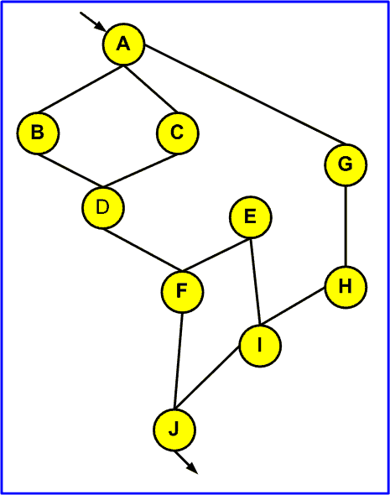
Coupling
Coupling of a component
C1
Example:
C2
CP(C₁) = 1/3
CP(C₂) = 2/3
CP(C₃) = 1/3
System Coupling:
CP = ((1/3)+(2/3)+(1/3))/3
= 4/9
= %45
C3

Slide 22
Coupling
Afferent Coupling (ca)
afferent coupling is the number of other packages that depend upon classes within this package. this value is good indicator of how changes to classes in this package would influence other parts of the software.
Efferent Coupling (ce)
efferent coupling is the number of other packages that classes from this package depend upon. this value indicates how sensitive this package is for changes to other packages. code with high ca and high ce is very hard to test and maintain, therefore, has very high complexity and is largely unstable.

Slide 23
Coupling
Instability (i)
instability is the ratio between efferent coupling (ce) and the total package coupling (ce + ca) which is based on the following formula
I = ce / (ce + ca)
It produces results in the range [0,1]. as i -> 0, this indicates a maximally stable package that is completely independent.
on the other hand, as i -> 1 this indicates a totally instable package that has no incoming dependencies but depends upon other packages.

Slide 24
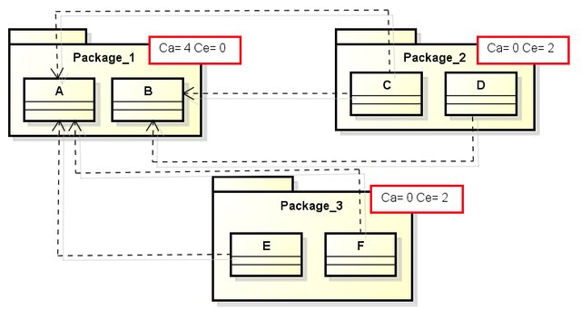
Coupling
Afferent Coupling (ca)
Who depends on you.
Incoming dependencies.
Efferent Coupling (ce)
Who do you depend on.
Outgoing dependencies.
For package1, we have two classes, A and B
Ca = {C, E, F} union {C, D} = {C, D, E, F} = 4
Ce = 0
Instability (I) = 0/(0+4) = 0
For package2, we have two classes, C and D
Ca = 0
Ce = {A, B} union {B} = {A, B} = 2
Instability (I) = 2/(0+2) = 1

Slide 25
Coupling
A
P
Afferent Coupling (ca)
Who depends on you.
Incoming dependencies.
Efferent Coupling (ce)
Who do you depend on.
Outgoing dependencies.
B
Q
C
Package1
Package2
For package1, we have three classes, A, B, C
Ca = {} union {} union {Q} = {Q} = 1
Ce = {P, Q} union {P} union {} = {P, Q,} = 2
Instability (I) = 2/(1+2) = 0.67
For package2, we have two classes, P, Q
Ca = {A, B} union {A} = {A, B} = 2
Ce = {} union {C} = {C} = 1
Instability (I) = 1/(2+1) = 0.33

